Slide 1
ONLINE TRAIN TICKET BOOKING
By
N.Lekha Sri-51897409

Slide 2
Abstract
The main aim of the project is to ease the process of railway reservation. This project is useful for improving standards of railway systems like checking different train timings and availability of trains between stations. It is the computerized system of reserving the seats of train seats in advanced. So we can generate the number of counters for the reservation of the seats and one can easily make reservations and get tickets by using this application.

Slide 3
ADMIN
Login
Add Delete View all records
Logout

Slide 4
Login
Database
Check availability
User
Reserve Ticket
Cancel Ticket

Slide 5
Technology Used
MySQL-store the data
HTML-Pages layout
CSS-for more attractive
JavaScript-Validation
JSP-Front-end purpose
Springs & Hibernate-Business Logic

Slide 6
Module
Generally this system contains two modules:
1. Admin Module
2. User Module
I. Admin Module
Firstly admin has to login and perform all the actions like
Admin can add new train records
Admin can see all the trains details
Only admin can edit and update the record of the train
Admin can able to delete the records of the train

Slide 7
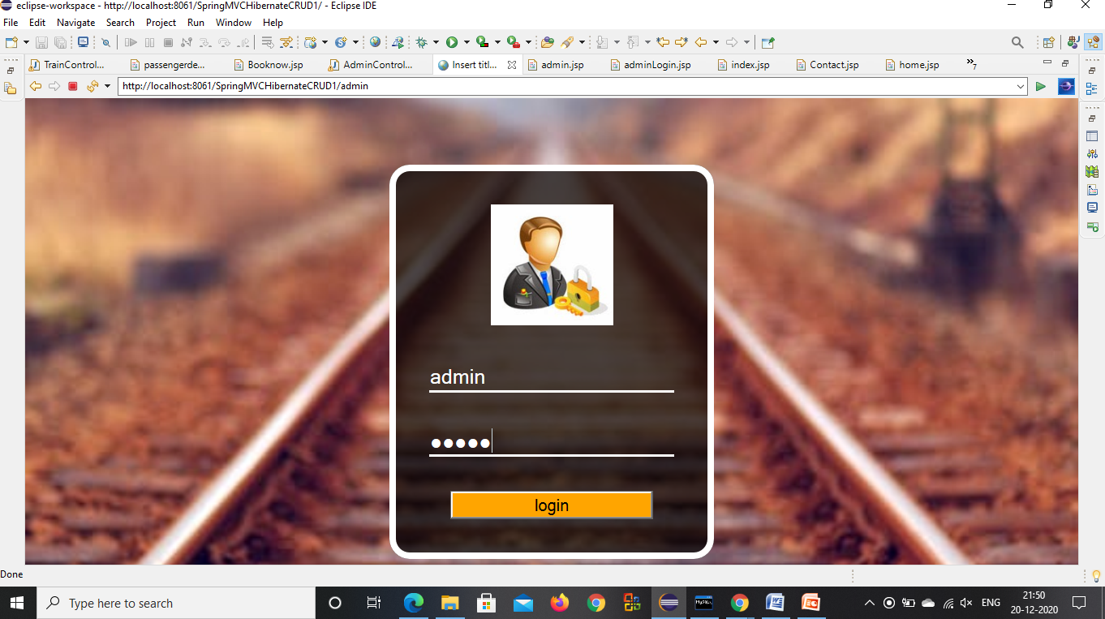

Slide 8
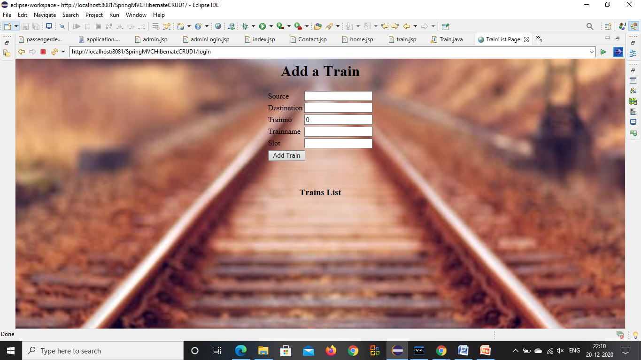

Slide 9
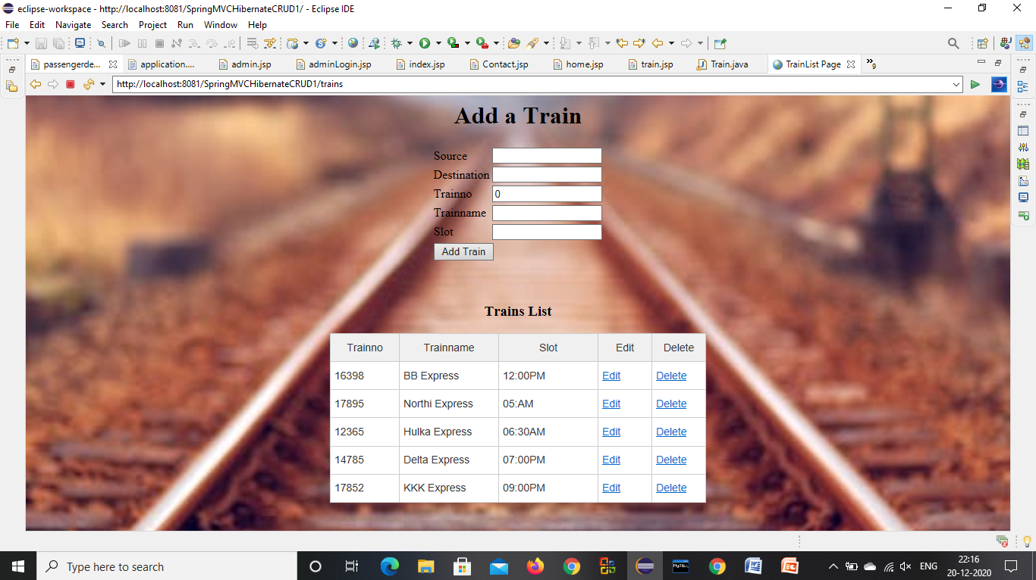

Slide 10
II. User Module
Now users should be registered and should have a valid login and password to make their reservation
Users register personal information, so they can order tickets in the system.
Users search train information through the system and see whether having appropriate tickets.
Users order tickets on the user interface. The system returns the result of ordering tickets information.
Users can select cancelling operation for some reasons, so the personal information will be removed from the system.

Slide 11
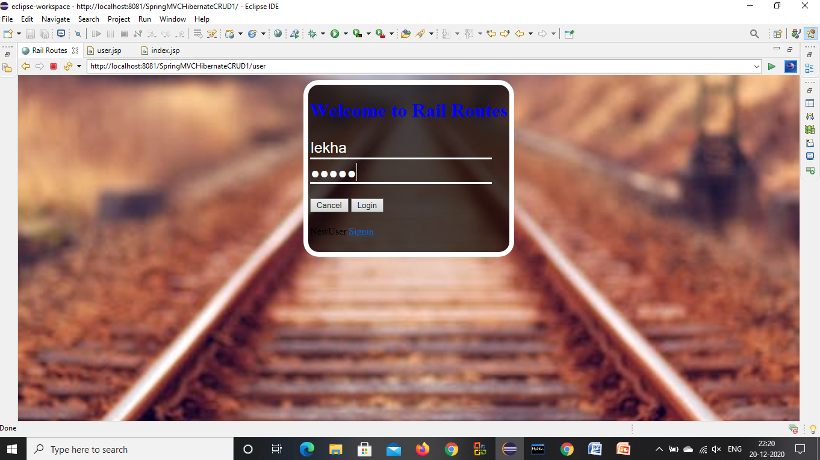

Slide 12
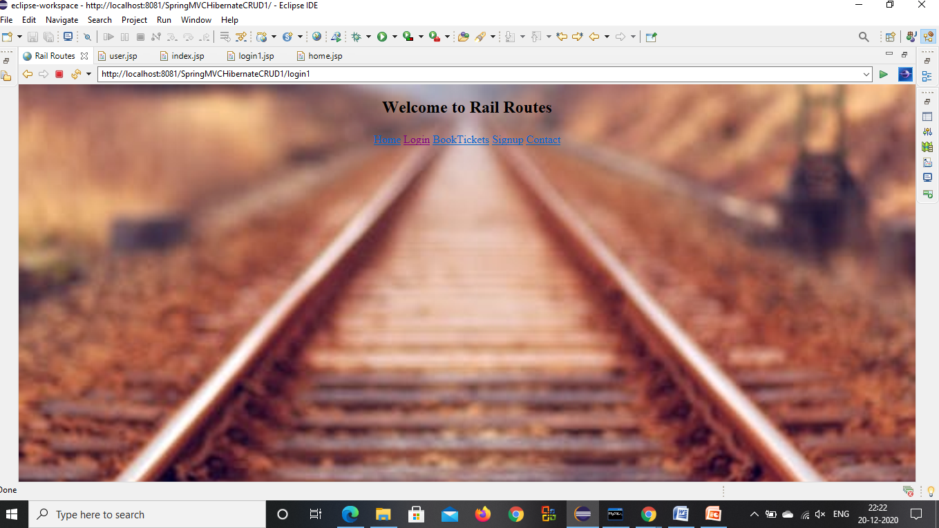

Slide 13
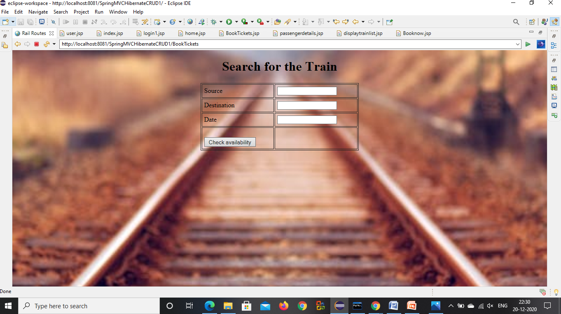

Slide 14
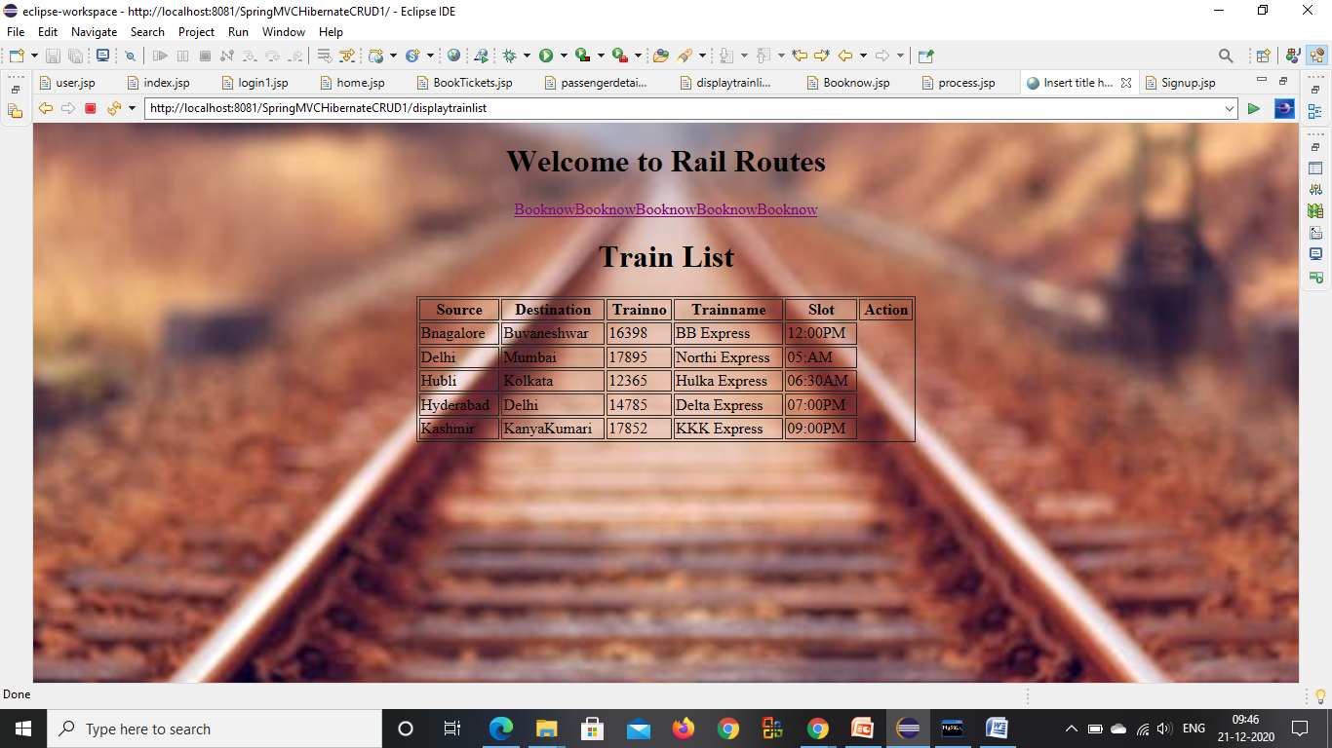

Slide 15
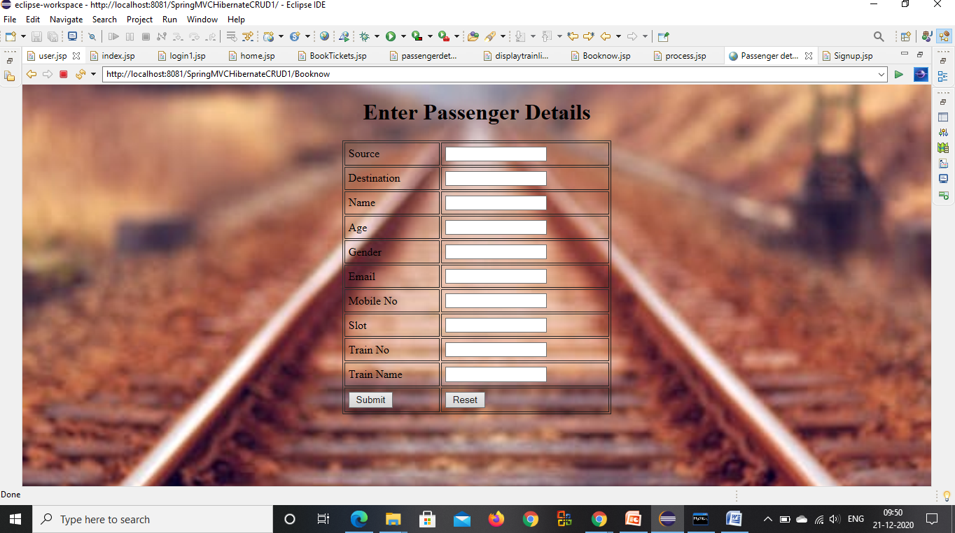

Slide 16
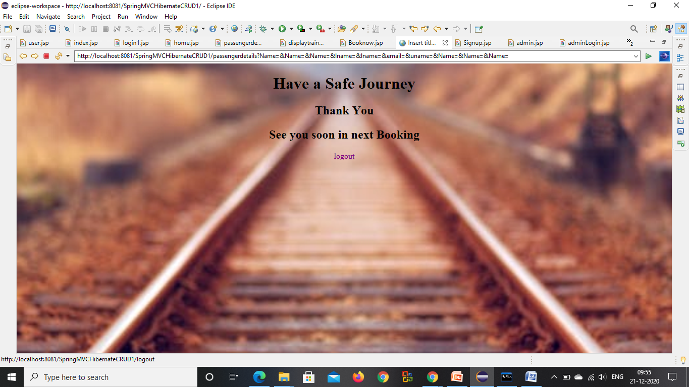

Slide 17
THANK YOU

